Slide 1
Fitness Tracker
By:
Corey Merritt
Jackson Hay
Aidan Fearn

Slide 2
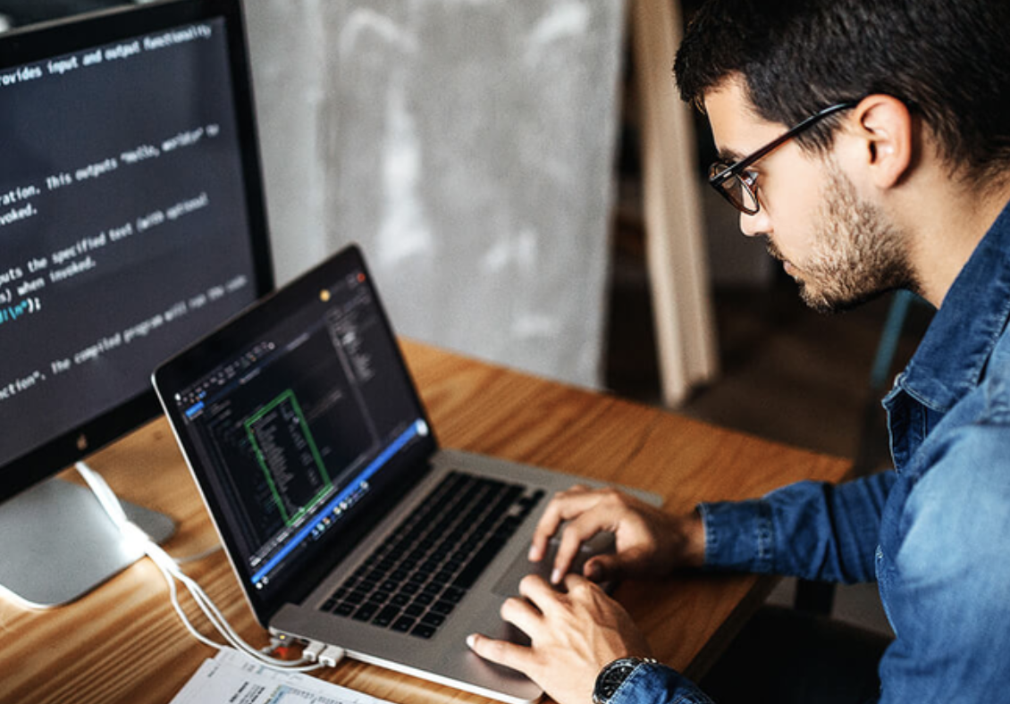
Introduction
Intro
Project Overview
Technical Details
Implementation
Challenges and Solutions
User Experience
Demonstration
Lessons Learned
Conclusion

Slide 3
Project Overview
To create a running app similar to programs like NIKE run club
Users will input their height, weight and age
Users input their run time and length
Will produce an output of calories burned and average pace

Slide 4
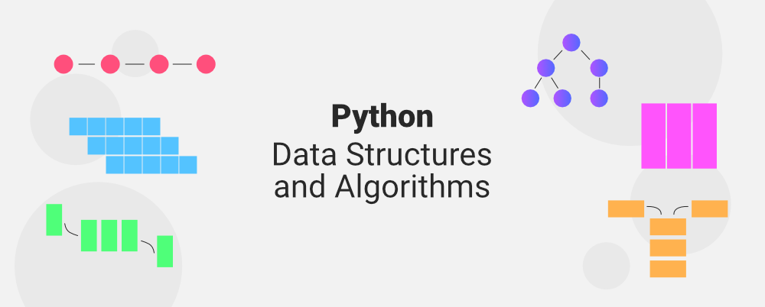
Technical Details
We are using python to create the algorithm
Will be using objects to define our functions in terms of BMI, Average Pace and Calories Burned
The code will then generate the results
Notes:
Corey

Slide 5
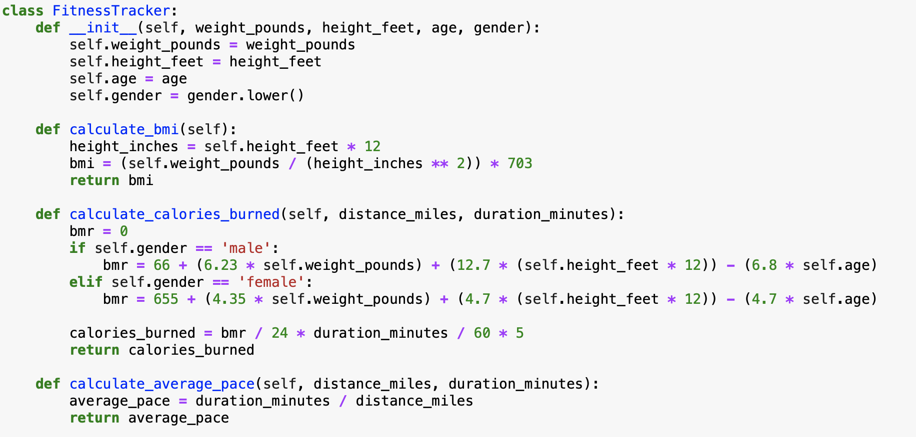
Implementation (1)

Slide 6
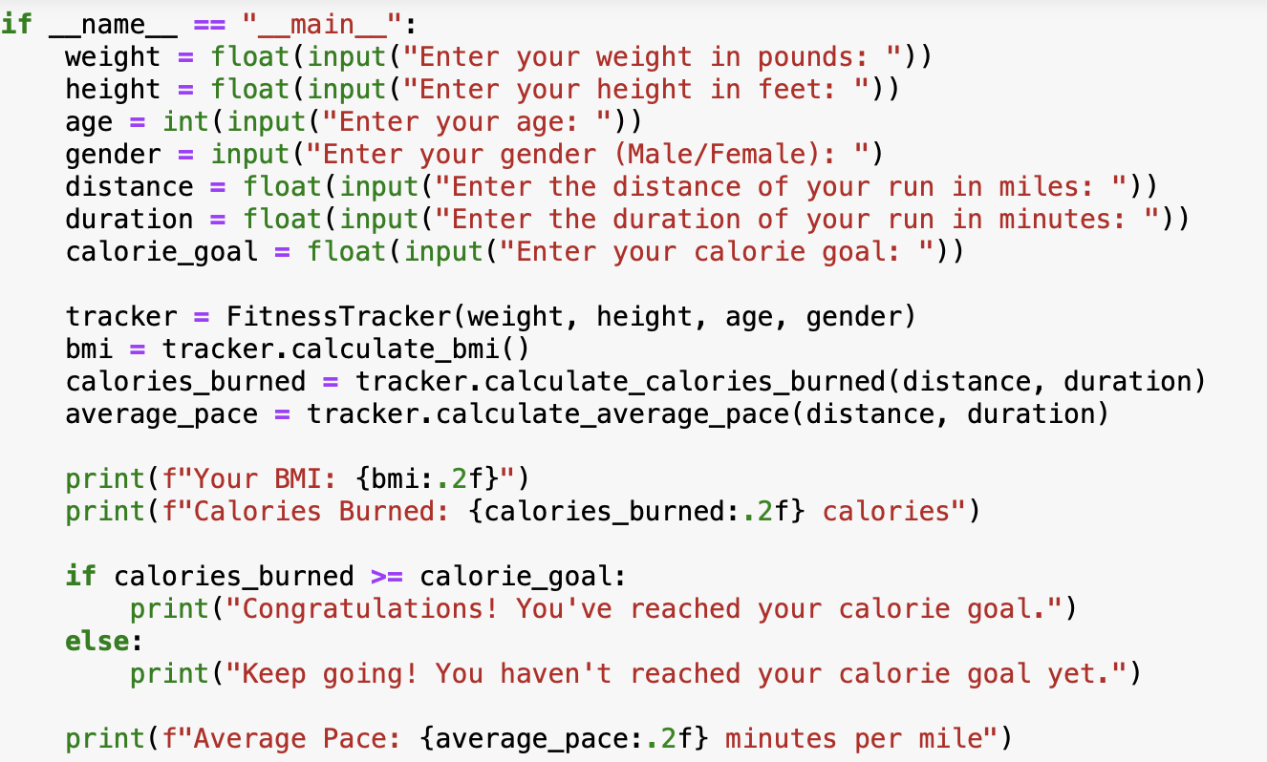
Implementation (2)

Slide 7
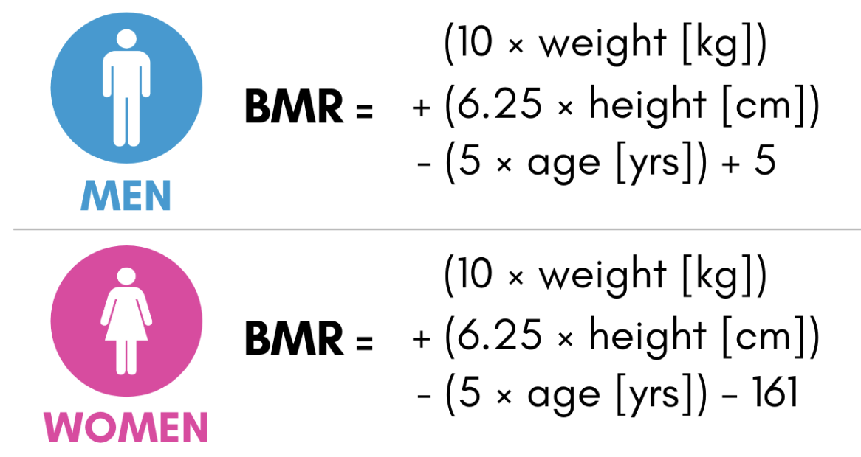
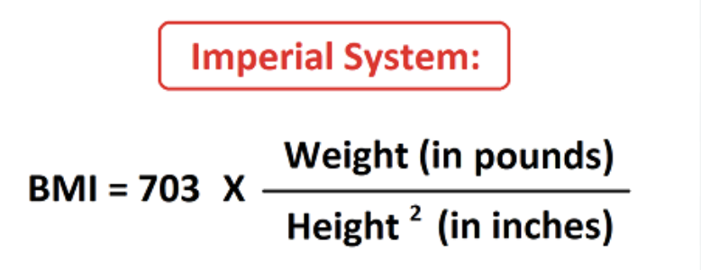
Challenges and Solutions
Defining the formulas for BMI and BMR
Notes:
Corey

Slide 8
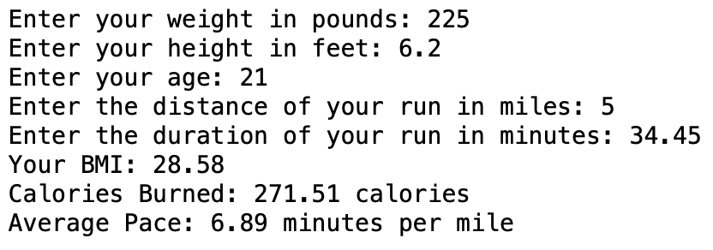
User Experience
Notes:
Corey

Slide 9
User Feedback
Tracks previous runs and compares progress
Make an option to convert in Kg and Cm
Expected results for future runs

Slide 10
Demonstration
https://drive.google.com/file/d/1LsR6airO_hKClHrYzBSRlSO8s41wVRNp/view?usp=drive_link

Slide 11
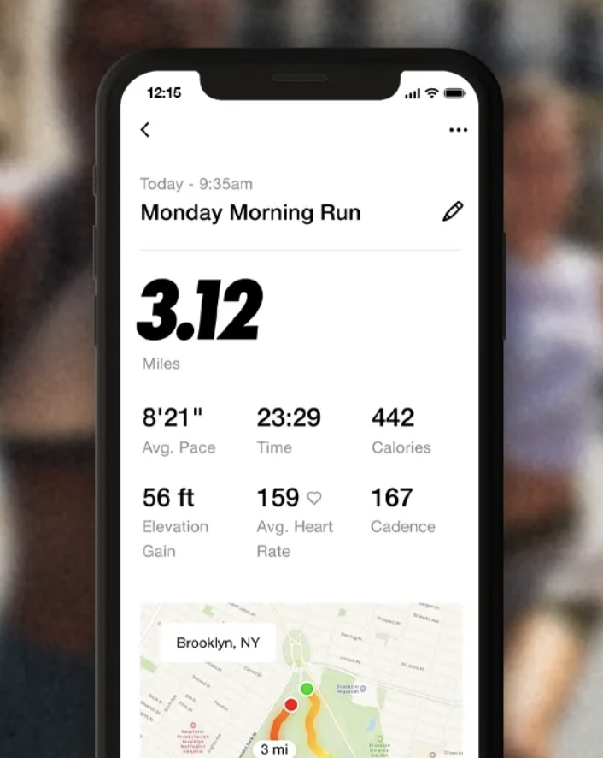
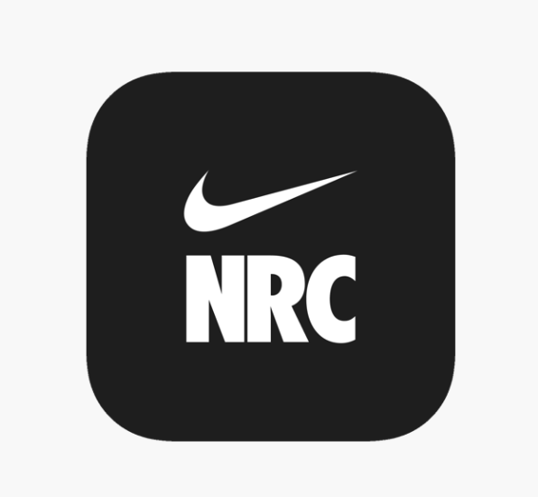
Nike Run Club
Notes:
Corey

Slide 12

Lessons Learned
How to proper use object in order to define your functions
How to tie functions together
How to use numerous inputs
If statements
Printing different statements depending on the given data

Slide 13

Conclusion

Slide 14
References
CDC - Calculating BMI using the English System - BMI for Age Training Course – DNPAO
BMR Calculator - Basal Metabolic Rate - Inch Calculator

